Slide 1

Employee Attrition
By Kaustubha Ram P
UNID:UMIP16580

Slide 2
Introduction
XYZ company which was established a few years back is facing around a 15% attrition rate for a couple of years. And it's majorly affecting the company in many aspects.
In order to understand why employees are leaving the company and reduce the attrition rate XYZ company has approached an HR analytics consultancy for analyzing the data they have. You are playing the HR analyst role in this project and building a dashboard which can help the organization in making data-driven decisions

Slide 3
Main KPIs
Attrition rate
Employee Turnover
Employee retention rate
Employee Satisfaction Rate
Job Satisfaction
Annual/Monthly Income
Retention rate per department
Retention rate per gender

Slide 4
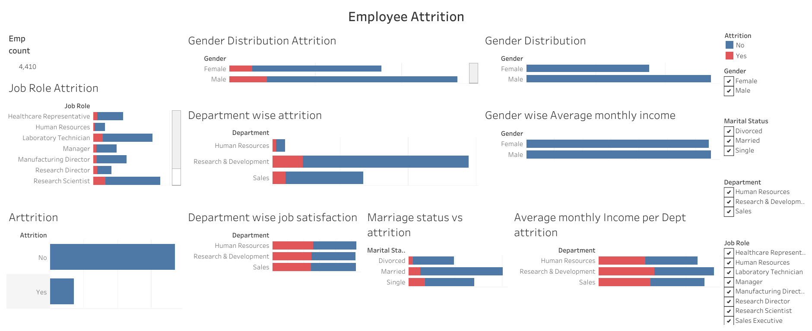
Dashboard

Slide 5
Key Insights
Attrition varies between departments
HR-30%- highest
R&D-16%
Sales-15%
Slight difference in attrition between males and females
Males-16.67%
Females- 15%

Slide 6
Key Insights
Income plays a factor
People who are leaving have lesser average income compared to those not leaving
HR has least average salary, and also has highest attrition among departments
Department\Attrition | Yes | N0
HR | 53,257 | 59,911
R&D | 63,756 | 67,828
Sales | 59,400 | 61,735

Slide 7
Key Insights
Marriage status is related to attrition
Divorcesd-10%
Married-12%
Single-25% - Highest attrition

Slide 8
THANK YOU

